Slide 1

Gherkin: Suggested Best Practices
Presented by Jared Sheffer

Slide 2
Overview
Suggestions
Keywords
Independent Feature/Scenario/Step
Connection to requirements
Combine where possible
Formatting
Imperative vs. Declarative
5 Rules of Modularity
Notes:
We will be reviewing some suggested best practices which I have seen succeed on many Cucumber Automation projects.
Our focus will be on (What) the best practice is.
And (Why) these best practices will help increase team efficiency and maintainability of the scripts
And Lastly (How) can we do this. I will go over a couple examples and take questions

Slide 3
Given, When, Then, But or And
Follow Gherkin standards on when to use the correct step keyword
Why?
Standardization
Readability
Notes:
Gherkin is written in plain English (Or what ever language you are using). It is meant to be readable by anyone. By Following the gherkin standards on when to use what keyword it helps promote standardization and readability.

Slide 4
Given, When, Then, But or And
Given – Precondition or setup (Must be first)
When – Action
Then – Assertion
And, But – Wild cards (They match the keyword above them)
But – Generally negative assertion (rarely used)

Slide 5
Given, When, Then, But or And
Examples
Given I login as “user1” (Precondition)
When I navigate to the “account” page (Action)
And I click on “sign out” on the “account” page (Action)
Then the “home page” should be displayed (Assertion)

Slide 6
Given, When, Then, But or And
Examples
Given I login as “user1” (Precondition)
When I navigate to the “account” page (Action)
And I click on “sign out” on the “account” page (Action)
Then the “home” page should be displayed (Assertion)
When I click on “sign in” on the “home” page (Action)
And I click on “sign in” on the “sign in” page (Action)
Then the “sign in” page should be displayed (Assertion)
And the “invalid user error” field should be “visible” (Assertion)
Notes:
An Assertion can be followed by an action but you always need to end your Scenarios with a assertion.
The And step is a wild card remember so if you have to change between a action, assertion or precondition make sure you use the named keywords and not the wildcards

Slide 7
Given, When, Then, But or And
Examples (BAD)
Given I login as “user1” (Precondition)
When I navigate to the “account” page (Action)
And I click on “sign out” on the “account” page (Action)
Then the “home” page should be displayed (Assertion)
And I click on “sign in” on the “home” page (Action)
And I click on “sign in” on the “sign in” page (Action)
And the “sign in” page should be displayed (Assertion)
And the “invalid user error” field should be “visible” (Assertion)
Notes:
In this example the have a And which is connected to a Then even though it is an action not an assertion. This is incorrect.

Slide 8
Make your steps information independent
Be as descriptive as possible with each step
There should be no identical steps across scenarios and feature files, unless they have the exact same purpose and impact
Why?
Automation
Readability
Notes:
Think of each step as a small program or snippet of code. It has no idea what ran before it or after it so it doesn’t know that you navigated to the sign in page 3 steps before unless you tell it.

Slide 9
Make your steps information independent
Examples
Given I click “accept”
Vs
Given I click “accept” out on the “payments” page
Notes:
What if you had different buttons in different places on the payments page vs the transactions page?
The top one only knows one way to click accept
The bottom one can look up how to accept on the account page or any other page we pass in.

Slide 10
Your Scenarios and Features are independent
Every scenario should be able to be executed alone
Every feature should be able to be executed alone
Why?
Automation
Maintainability
Readability
Notes:
Each scenario in a feature needs to make sense and be able to be executed independently of any other scenario. This means, in a feature we cannot build dependency between scenarios.

Slide 11
Make your steps information independent
Examples (Bad)
Scenario: good description here
Given I login as “user1”
When I add a loan to the “user1” account
Then an “account” element should be “visible” on the “home” page
Scenario: A better description here
Given I click on the “account” element on the “home” page
Then the “account number” should be visible on the “account” page
Notes:
The second scenario requires the first to run.

Slide 12
Make your steps information independent
Examples (Better)
Scenario: good description here
Given I login as “user1”
When I add a loan to the “user1” account
Then an “account” element should be “visible” on the “home” page
When I click on the “account” element on the “home” page
Then the “account number” should be visible on the “account” page
Notes:
We combined both scenarios into one

Slide 13
Make your steps information independent
Examples (Best)
Background: Login and create add account to user
Given I login as “user1”
And I add a loan to the “user1” account
Scenario: good description here
Then an “account” element should be “visible” on the “home” page
When I click on the “account” element on the “home” page
Then the “account number” should be visible on the “account” page
Notes:
This would be best if every one of your steps has to execute these 2 steps first.

Slide 14
Numbering Scenarios
Numbering your scenarios will help find it’s location if it fails
Scenario: PROJECT_FEATURE_NUMBER : good description here
Given precondition
When action
Then assertion on result
PROJECT_FEATURE_NUMBER example: PEC_Login_1
Notes:
Numbering your scenarios will help find it’s location if it fails.
The numbering should follow the format of ProjectName_FeatureName_NumberOfTheScenario

Slide 15
Connect your scenarios to your requirements
Keep track of what scenarios included in a requirement
Why?
Traceability
Coverage
Metrics
Notes:
It allows you to easily trace a scenario to a requirement.
This helps to verify that you have complete coverage for that requirement even if it changes
If you keep a common format for this connection then you can code a formatter as part of your test execution to show for example how many of a particular requirement ran or failed

Slide 16
Connect your scenarios to your requirements
Examples
Feature: If the whole feature covers requirements
Scenario: Description of the scenario followed by the requirement: RLS-1003, QD-1789
If you do not want the requirement to be visible when a test fails add it as a comment above the scenario.
# RLS-1003, QD-1789
Scenario: Description of the scenario followed by the requirement
Notes:
The requirement id should come from the repository where your requirements are recorded such as Jira, TeamForge, RTC, etc.

Slide 17
Combine Your Common Scenarios
If most steps are the same
Consider a scenario outline combination
Why?
Ease of Readability and Maintainability
Modifying steps – One place Vs Many

Slide 18
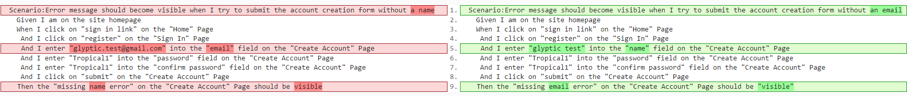
Combine Your Common Scenarios
How?
Notes:
You can use text compare tools to quickly compare two scenarios.

Slide 19
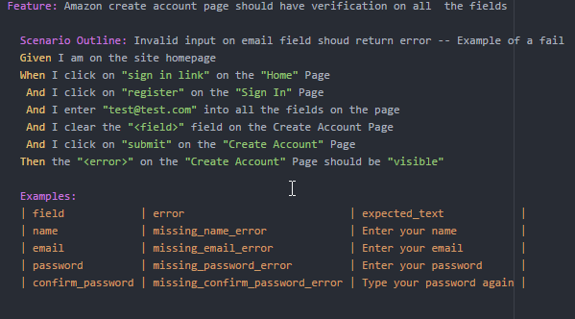
Combine Your Common Scenarios
How?
Notes:
Scenario Outlines are the best way to combine similar scenarios

Slide 20
Formatting
Keep your tables organized:
BAD
|over_all_credit_score|user|page_header|
|N/A|user0|account details|
|300|user24|home|
||user9|business banking print summary|
|570|user1|sign in|
GOOD
| over_all_credit_score| user | page_header |
| N/A | user0 | account details |
| 300 | user24 | home |
| | user9 | business banking print summary |
| 570 | user1 | sign in |
Notes:
Tables which are not formatted will be nearly impossible to read.

Slide 21
Formatting
If your using a step table add a colon : at the end of your step
Then each result should have the following information:
| information | data_type |
| title | string |
Notes:
A colon helps show that this step should always be followed by a data table.

Slide 22
Imperative vs. Declarative
Imperative: Long low level steps to drive the user interface.
More steps
Longer scenarios
More detail on how test is done
Declarative: Describes what a user does not how they do it.
Contains all the needed detail and no more.
More easily readable
Notes:
There is a good chance that when you start writing Gherkin you’ll start with an Imperative style of scenarios.

Slide 23
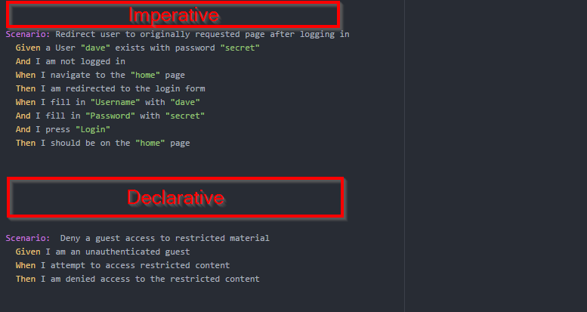
Imperative vs. Declarative Example
Notes:
Many people prefer to write in a Declarative style but from an automation point of view it might tempting to go with Imperative.

Slide 24
Declarative vs. Imperative
Imperative: Long low level steps to drive the user interface.
More steps
Longer scenarios
More detail on how test is done
Declarative: Describes what a user does not how they do it.
Contains all the needed detail and no more.
More easily readable
Notes:
There is a good chance that when you start writing Gherkin you’ll start with an Imperative style of scenarios. They are simple and obvious but it is recommended by cucumber standards to avoid them.

Slide 25
Test Data – JSON Files
Test data needs should be clearly communicated to both the Test Data Management team as well as the Automation team via:
Test data request sheet
When your test is data driven use a JSON file
Then all user data for “johnDoe” from “users.json” is populated on the “home” page
Notes:
If you have a large amount of data which needs to be validated in your tests it is best practice to reference an external data source such as a JSON file.
For example a test where you need to verify user account data would likely contain a lot of data and thus would be best suited to be read from a JSON file

Slide 26
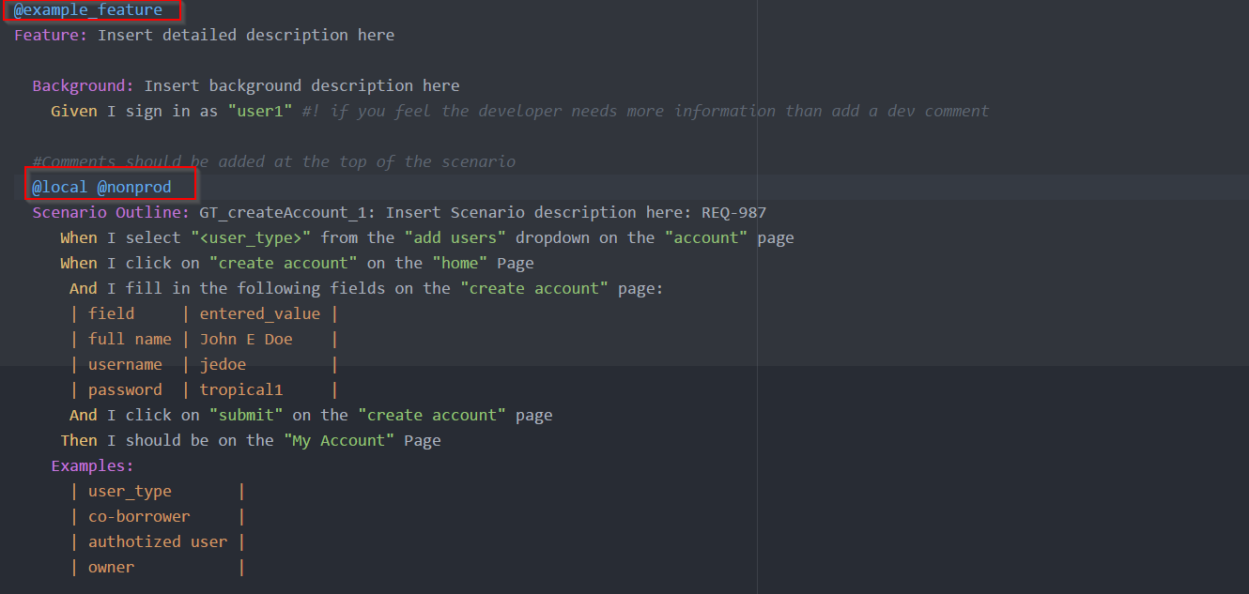
Cucumber Tags
Cucumber tags are a way of grouping tests
Tags go above the intended feature or scenario.

Slide 27
Make your steps modular
What?
Be constant with your language.
Use parameters and make them clear
Why?
Ease of automation
Ease of reading
Standardization
Notes:
Be constant with your language.
Use parameters and make them clear
Make sure that if your steps do the same thing that they are worded the exact same way
Follow the 5 rules of modulatory
Modularity will help make automation of these scripts easier because it will allow the use of modern frameworks and eliminate code duplication
It will be easier to read and create the gherkin
It will help all the projects get on the same page

Slide 28
Make your steps modular
How?
Rule 1: If does the same thing make it obvious
Example:
Given I click on Sign In link on the Home page
When I click on the Register Button on the Sign In page
When I click on “something” on the “somewhere” page
Notes:
When determining if steps are different or not you should ignore the keywords (i.e. Given When Then…) Cucumber ignores these when matching a step definition. Just because one has a Given and one has a When it does not make them 2 different behaviors and the step definition would be a common single step definition if done properly
Add quotes to make if obvious if something can be swapped out.

Slide 29
Make your steps modular
How?
Rule 2: Keep case consistent: lowercase recommended
Example:
Given I Click on “Sign In link” on the “Home” page
Given I click on “Sign In link” on the “Home” page
These will not execute the same step
Notes:
Cucumber uses regular expressions to match your steps. If you are not consistent with your wording than either. The regular expression must be updated to take all your possible wordings into account
Which leads to code duplication
Which leads to unmaintainable tests
Or the developer must update your steps to make them consistent.

Slide 30
Make your steps modular
How?
Rule 3: Keep tables consistent
Example:
Then the "<Error>" should be "visible" and contain "<Expected Text>"
Vs
Then the "<error>" should be "visible" and contain "<expected_text>"
Examples:
| error | expected_text |
Suggested: lowercase and underscore separated
Notes:
When developing an application or an automation test suite it is common practice to down case all data in which case is not a factor.
It is suggested to keep your variables and headers all lowercase and underscore separated
Use spaces to format tables since tabs render differently in various editors

Slide 31
Make your steps modular
How?
Rule 4: Include all needed information as if the feature, scenario, or step were alone
Example:
When I click on "sign in "
And I enter the "user0 " data
vs
When I click on "sign in link" on the "home" page
And I enter the "user0" data from the "dev_users.json" file
Notes:
Features and scenarios should never rely on other features or scenarios
Each feature, scenario, and step should be independent.
Features and Scenarios can not require data to be passed between them or anything to be done by another feature or scenario
View all of your scenarios as if they were the only one which existed
Steps can rely on other steps but should not share data

Slide 32
Make your steps modular
How?
Rule 5: Don’t use Microsoft Word to create your steps
Example:
When I click on "sign in link" on the "home" page
When I click on “sign in link” on the “home” page
- Microsoft uses smart quotes
Notes:
Microsoft uses smart quotes so don’t use it to write your gherkin. If you do then cleanse it before delivery
The smart quotes are not rendered in the same manner as the standard quote character

Slide 33
Other quick rules
Comments -
If your step or scenario contains logic which might be complicated for the developer. Add a comment in the following format.
#! Insert dev comment to be removed by dev once implemented
# Insert general comment which will stay.
Keep general comments at the top of your scenario or feature. Place dev comments where needed
Step Length:
Try to keep your steps concise and to the point. As a general rule keep them
under 100 characters and ideally between 50 and 80 characters

Slide 34
Questions?
Notes:
The parameters from the step can be used in the implantation language.
In this example I am using Ruby with a page object model.

